Slide 2
JEOPARDY!
PLAY!
Cyberbullying and Relational Aggression
Creative Response to Conflict 2011

Slide 3
Regular Jeopardy
DEFINITIONS
TYPES
TRIVIA &
STATISTICS
COMMUNICATION
TECHNOLOGY
POP
CULTURE
10
10
10
10
10
20
20
20
20
20
30
30
30
30
30
40
40
40
40
40
50
50
50
50
50

Slide 4

Answer 1A
DEFINITION: ANY OVERT ACTS REPEATED OVER TIME BY AN INDIVIDUAL OR GROUP DIRECTED AT ANOTHER, BECAUSE OF A REAL OR IMAGINED POWER DIFFERENCE, WITH THE INTENT TO INTIMIDATE, RIDICULE OR HUMILIATE

Slide 5
Question 1A
WHAT IS
BULLYING?

Slide 6
Answer 1B
initials that refer to "lesbian, gay, bisexual, transgender, queer and questioning" people

Slide 7
Question 1B
WHAT IS
LGBTQQ?

Slide 8
Answer 1C
AN IRRATIONAL FEAR OF
OR AVERSION to lesbian, gay, bisexual, transgender, queer or questioning individuals

Slide 9
Question 1C
WHAT IS
HOMOPHOBIA?

Slide 10
Answer 1D
A TYPE OF INDIRECT AGGRESSION CAUSING HARM USING INFORMATION OR COMMUNICATION TECHNOLOGY FOR DELIBERATE AND REPEATED HARASSMENT OR THREAT

Slide 11
Question 1D
WHAT IS
CYBERBULLYING?

Slide 12
Answer 1E
A TYPE OF INDIRECT
AGGRESSION THROUGH
MANIPULATION OF
INTERPERSONAL
RELATIONSHIPS AND
SOCIAL STATUS

Slide 13
Question 1E
WHAT IS RELATIONAL
OR SOCIAL AGGRESSION?

Slide 14
Answer 2A
WHEN THE BULLY
TELLS OTHERS
PERSONAL OR PRIVATE UNPROVEN INFORMATION
ABOUT THE VICTIM

Slide 15
Question 2A
WHAT IS GOSSIPING
OR RUMOR SPREADING?

Slide 16
Answer 2B
WHEN THE BULLY
IMITATES OR COPIES A REAL OR IMAGINARY PERSON IN ORDER TO DIRECTLY INJURE OR GAIN INFORMATION FROM THE VICTIM

Slide 17
Question 2B
WHAT IS IMPERSONATION?

Slide 18
Answer 2C
WHEN THE ABUSER
PREVENTS THE VICTIM FROM SOCIALIZING WITH A GROUP,
BY ACTIVELY RIDICULING OR PASSIVELY IGNORING

Slide 19
Question 2C
WHAT IS EXCLUSION
OR SOCIAL REJECTION?

Slide 20
Answer 2D
WHEN THE ABUSER
CREATES A MADE-UP ONLINE IDENTITY FOR THE SAKE OF BULLYING

Slide 21
Question 2D
WHAT ARE FAKE ONLINE PROFILES?

Slide 22
Answer 2E
WHEN THE ABUSER
INTIMIDATES THE VICTIM INTO DOING SOMETHING WITH
THREATS TO SOCIAL STATUS

Slide 23
Question 2E
WHAT IS MANIPULATION
OR COERCION?

Slide 24
Answer 3A
DIRECT (OR PHYSICAL) AGGRESSIVE BEHAVIOR OCCURS MORE OFTEN
IN THIS GENDER GROUP

Slide 25
Question 3A
WHAT ARE BOYS?

Slide 26
Answer 3B
STUDIES SHOW THAT PARTICIPATION IN
RELATIONAL BULLYING
CAN BE AFFECTED BY
INCREASED EXPOSURE
TO THIS

Slide 27
Question 3B
What is
television?
(Mason, Hammel, Brace & Vitale 2008)

Slide 28
Answer 3C
THE PERCENTAGE OF CYBERBULLYING THAT OCCURS AT HOME FOR INTERNET USERS AGE 10-17

Slide 29
Question 3C
What is 85%?
Wolak, Mitchell & Finkelhor (2006)

Slide 30
Answer 3D
KIDS IDENTIFIED AS BULLIES AT AGE 8 ARE THIS MANY TIMES MORE LIKELY TO HAVE A CRIMINAL CONVICTION BY AGE 24

Slide 31
Question 3D
What is 6?
NRCSS (1999)

Slide 32
Answer 3E
CYBERBULLYING CAN ESCALATE TO THIS ARRESTABLE OFFENSE

Slide 33
Question 3E
WHAT IS CYBERSTALKING?

Slide 34
Answer 4E
A TYPE OF WEBSITE WHERE PERSONAL ENTRYS ARE MADE COMMENTING ON A SUBJECT

Slide 35
Question 4E
What IS a
BLOG?

Slide 36
Answer 4A
A POPULAR SOCIAL NETWORKING SITE USED TO UPDATE PERSONAL PROFILES; ADD FRIENDS; SEND MESSAGES; CREATE INTEREST GROUPS; AND JOIN WORKPLACE, SCHOOL, AND CITY NETWORKS

Slide 37
Question 4A
What is
Facebook?

Slide 38
Answer 4B
COMMUNICATION METHOD INVOLVING SHORT MESSAGES SENT TO AND FROM CELL PHONES OR MOBILE DEVICES

Slide 39
Question 4B
What is
Texting?

Slide 40
Answer 4C
A POPULAR SOCIAL NETWORKING AND
BLOGGING SITE WITH
TEXT-BASED POSTS
LIMITED TO 140 CHARACTERS

Slide 41
Question 4C
What is
Twitter?

Slide 42
Answer 4D
A REAL-TIME
ONLINE EXCHANGE
OF MESSAGES USING A SOFTWARE CLIENT WITH ACCEPTED USERS ON A “BUDDY LIST”

Slide 43
Question 4D
What is
Instant messaging?

Slide 44
Answer 5A
THIS POPULAR 2004 TEEN
COMEDY FILM FEATURED RELATIONAL BULLYING IN A PUBLIC HIGH SCHOOL SETTING, WRITTEN BY AND STARRING
TINA FEY

Slide 45
Question 5A
What is Mean Girls?

Slide 46
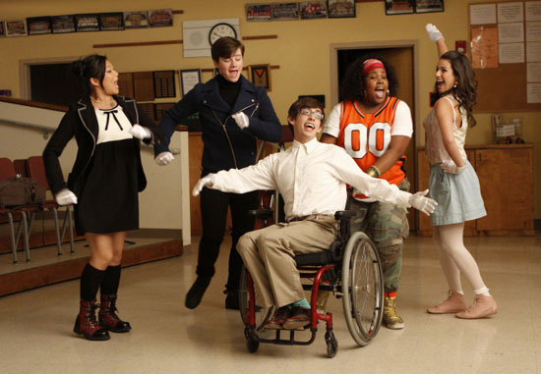
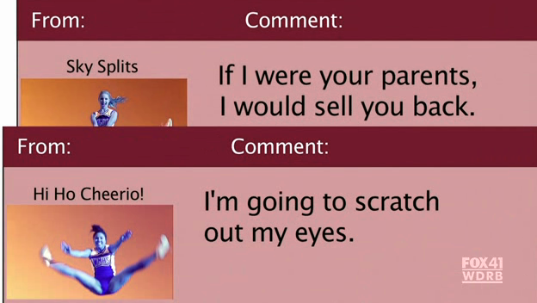
Answer 5B
NAME THE POPULAR
TELEVISION SHOW:

Slide 47
Question 5B
What is glee?

Slide 48
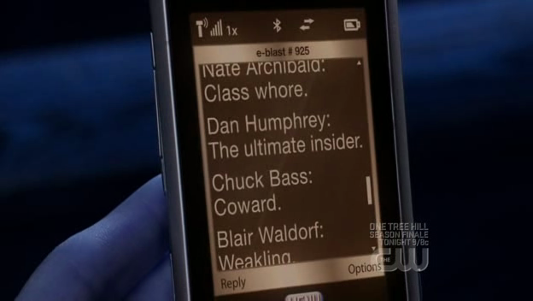
Answer 5C
THIS TELEVISION SHOW FEATURES NARRATION BY AN OFF-SCREEN ONLINE BLOGGER

Slide 49
Question 5C
WHAT IS GOSSIP GIRL?

Slide 50
Answer 5D
A WEBSITE WHERE USERS CAN upload, share and view personal videos

Slide 51
Question 5D
WHAT is YOUTUBE?

Slide 52
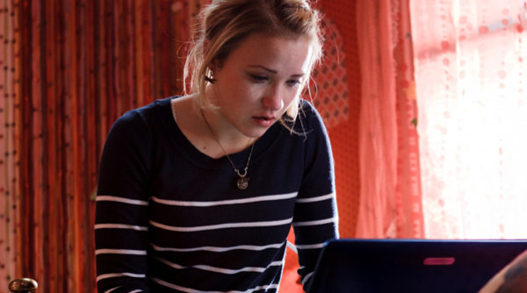
A new ABC family movie about a 17 year old high school girl who experiences Cyberbullying

Slide 53
WHAT is the 2011 movie called Cyberbully?

Slide 54
Regular Jeopardy
DEFINITIONS
TYPES
TRIVIA &
STATISTICS
COMMUNICATION
TECHNOLOGY
POP
CULTURE
10
10
10
10
10
20
20
20
20
20
30
30
30
30
30
40
40
40
40
40
50
50
50
50
50

